Slide 1
Customer segmentation & personas
By: melgwyn wullur

Slide 2
Project objective
Objective
To segment customers based on demographic and behavioural patterns in order to develop tailored marketing strategies that enhance engagement and product uptake.
Demographic & Behavioural (Age, Job, Education, Loan Status)
Bank Marketing Dataset (UCI Repository) in Kaggle
Dataset Used
Segmentation Type

Slide 3
Methodology

Slide 4
Methodology
1. Data Pre-processing: Cleaned nulls, encoded categorical features & Removed outliers in age and income
2. Clustering: Applied K-Means clustering & Selected K=5 based on Elbow Method
3. Persona Development: Created customer profiles based on cluster characteristics & Designed strategic marketing recommendations

Slide 5
K number results COMPARISON Test
After testing k-means using the Silhouette score and Davies-Bouldin Index, statistically K=2 is the best solution but after testing, K=2 only produces broad clusters while K = 5 provides more granular segmentation and rich personas for marketing action
Cluster Numbers | Statistical Fit | Cluster Quality | Example Personas | Business Impact
2 | Best (Silhouette = 0.60, DB = 0.56) | Very stable but broad | Group A: Younger, admins, uni degree, loans active Group B: Older, blue-collar, basic education | Overgeneralized clusters causes difficulty in targeting
4 | Balanced (Silhouette = 0.47, DB = 0.60) | Moderate separation | 1. Younger admins, uni degree 2. Older admins, uni degree 3. Blue-collar, basic ed. 4. Management, uni degree | More specific but misses niche details like no loans
5 | Weaker (Silhouette = 0.47, DB = 0.60) | Specific separation | 1. Mid-age admins, uni degree 2. Younger admins, early career 3. Blue-collar, basic ed. 4. Management, high ed. 5. Blue-collar, no loans (low engagement) | Slightly weaker metrics but best personas for strategy

Slide 6
analysis

Slide 7





Results overview
Cluster Name | Cluster | Size | Avg Age | Housing Loan % | Personal Loan % | Top Job | Top Education
Mid-life Professionals | 0 | 18,910 | 43.3 | 53.8% | 15.5% | Admin (33.2%) | University Degree (30.5%)
Young Professionals | 1 | 10,628 | 32.7 | 55.1% | 16.1% | Admin (36.7%) | University Degree (38.2%)
Working Class Traditionalist | 2 | 7,807 | 41.3 | 51.8% | 15.0% | Blue-collar (96.6%) | Basic (80.7%)
Affluent Executives | 3 | 2,853 | 42.4 | 52.2% | 15.4% | Management (100%) | University Degree (70.5%)
Financially unengaged outliers | 4 | 990 | 40.0 | 0.0% | 0.0% | Blue-collar (24.2%) | Basic (33.1%)

Slide 8

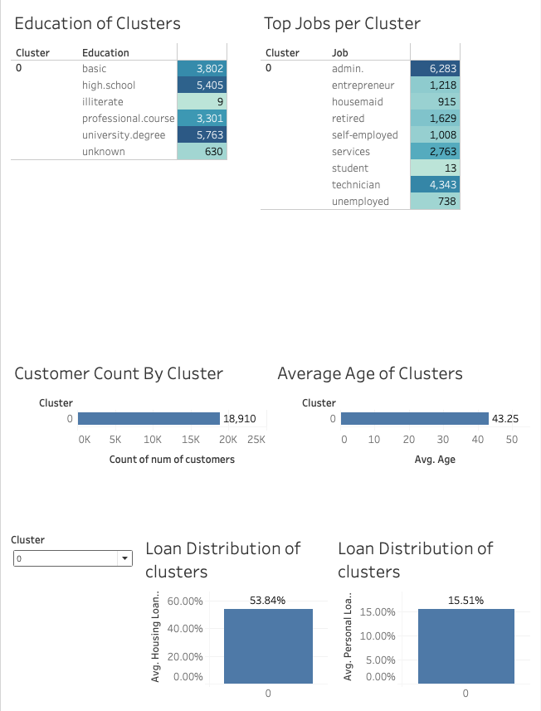




Cluster 0 (mid-life professionals)
N= 18,910 cluster consists of mostly high school and above education with an average age of 43 and mostly have housing loans (54%) while some have personal loans (15%) who work as an admin or electrician
Profile: Aged 40+, educated, employed in administrative roles. Stable income and homeownership.
Strategy: Promote refinance and insurance bundles
Channels: Email, Mobile App
Message: "Secure your future with flexible options”

Slide 9

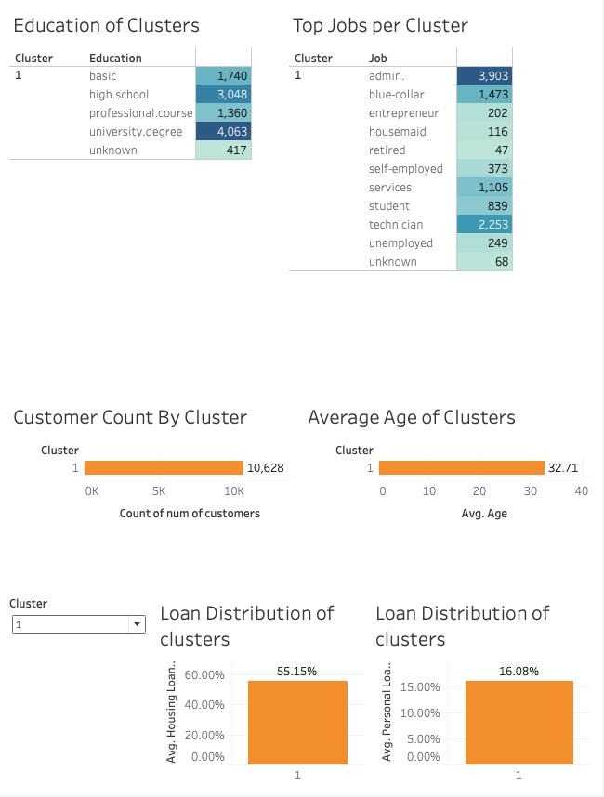
Cluster 1 (Young professionals)
N= 10,628 cluster consists of mostly high school and above education with an average age of 32 and mostly have housing loans (55%) while some have personal loans (16%) who work as an admin or electrician
Profile: Young, well-educated, early career, new financial responsibilities
Strategy: Offer first-time mortgages, credit cards with rewards
Channels: Social Media, Mobile Banking
Message: "Smart financial tools for your growing goals"

Slide 10

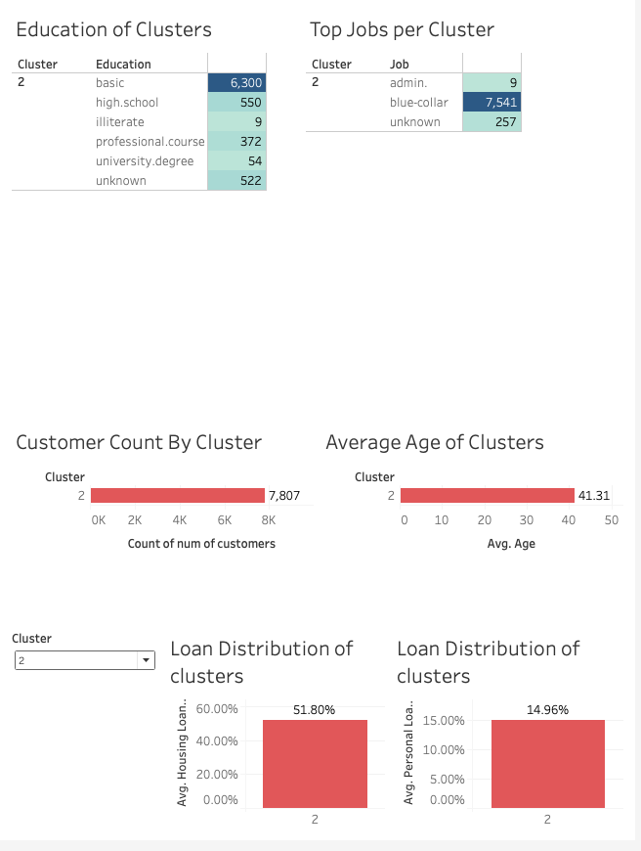
Cluster 2 (Working class traditionalists)
N= 7,807 cluster consists of mostly basic education with an average age of 41 and mostly have housing loans (52%) while some have personal loans (15%) who work as a blue-collar worker
Profile: Manual workers, modest education, risk-averse financial habits
Strategy: Simplified savings and loan products
Channels: SMS, Branches
Message: "Banking that works for you"

Slide 11

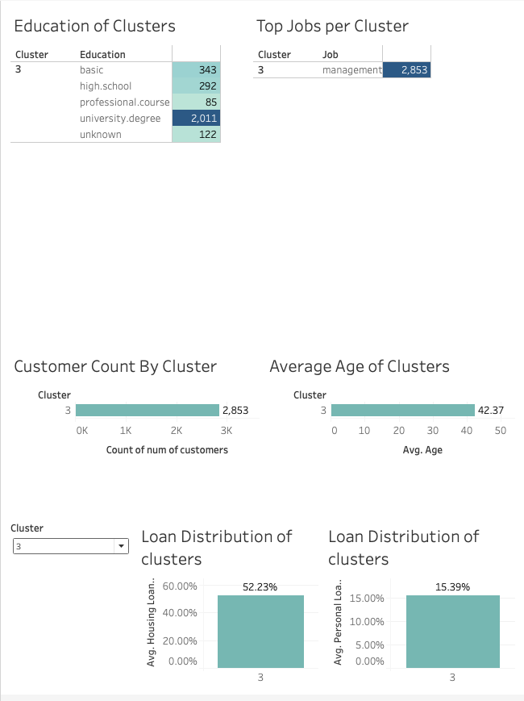
Cluster 3 (Affluent executives)
N= 2,854 cluster consists of mostly university education with an average age of 42 and mostly have housing loans (52%) while some have personal loans (15%) who work as a manager
Profile: Managers, highly educated, higher income bracket
Strategy: Wealth management services, portfolio products
Channels: Relationship Managers, App
Message: "Tailored solutions for your lifestyle"

Slide 12
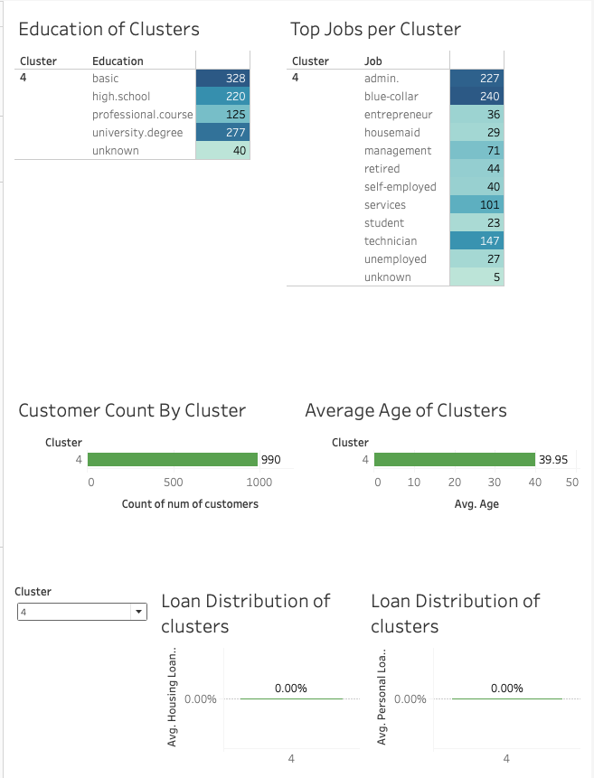
Cluster 4 (Financially unengaged outliers)
N= 990 cluster consists of varying education and occupation with an average age of 41 and have no personal or home loans
Profile: Mixed background, disengaged from financial products
Strategy: Financial literacy programs, no-fee accounts
Channels: Community Outreach
Message: "Start with one small step"

